Slide 1

DISASTER RELIEF RESOURCE MANAGEMENT SYSTEM
Presented by
Eeranki Sri Surya Krishna Karthik – 25B11CS253
Kamepalli Venkata Akhilesh – 25B11CS381
Chokka Sri Sowmya – 25B11CS194
Boddu Lakshmi Surya Sahithi – 25B11CS115
Under the Supervision of
Dr. M.V.B. Murali Krishna

Slide 2


OUTLINE OF THE TALK
Introduction
Problem Statement
Current Scenario
Literature Survey
Proposed System
Objectives
Technology Stack
System Architecture
System Requirements
Conclusion
References

Slide 3
INTRODUCTION
A DBMS-based system designed to manage disaster relief operations efficiently.
Stores and organizes information about disasters, victims, resources, volunteers, and relief centres.
Provides a centralized database for quick access to important information.
Helps to track available resources and their distribution to affected areas.
Maintains records of victims and their assistance requirements.
Supports better coordination between volunteers and relief centres.
Reduces resource wastage, duplication, and delays during relief operations.
Ensures that relief resources are properly managed and delivered to those in need.

Slide 4
PROBLEM STATEMENT
Disaster relief data is often scattered and difficult to manage.
Manual records can cause errors and duplicate data.
Tracking victims and their needs is challenging.
Resource availability is difficult to monitor.
Poor coordination can cause delays in relief distribution.
Resources may be misallocated or wasted.
Volunteer and relief centre information can be difficult to coordinate.
A centralized DBMS is needed for efficient disaster relief management.

Slide 5
CURRENT SCENARIO
Disaster relief operations often depend on manual records and scattered information.
It is difficult to get real-time information about available resources.
Resources may be unevenly distributed or wasted due to poor coordination.
Victim information and their requirements may be difficult to track accurately.
Coordination between volunteers, relief centres, and authorities can be challenging.
Lack of a centralized system can lead to delays and duplicate records.
There is a need for a centralized DBMS to manage and access disaster-related data efficiently.
A well-organized system can help ensure faster and more effective relief distribution.

Slide 6
LITERATURE SURVEY
Studied existing disaster management systems.
Reviewed DBMS-based relief systems.
Focused on resource and victim management.
Centralized databases improve data access.
Identified issues in coordination and tracking.
Need for efficient resource allocation.
Connected victims, resources, and volunteers.
Proposed a centralized relational database.

Slide 7
PROPOSED METHODOLOGY
Centralized DBMS System
Store Disaster-Related Data
Manage Victims, Resources & Volunteers
Track Relief Centres & Distribution
Access & update data quickly
Improve Allocation & Reduce Wastage
Faster & Efficient Relief Operations

Slide 8
OBJECTIVES
Create a centralized disaster database.
Manage victim information efficiently.
Track resources and their availability.
Manage volunteers and relief centres.
Monitor relief resource distribution.
Reduce data duplication and resource wastage.
Improve coordination and decision-making.
Ensure fast and efficient relief management.

Slide 9
TECHNOLOGY STACK
Frontend: HTML, CSS
Backend: PHP / Python
Database: MySQL
Database Tool: MySQL Workbench
Query Language: SQL
Development Tool: VS Code
System Type: Web-based DBMS Application

Slide 10
ARCHITECTURE & MODULES
User Interface – Provides access to the system.
Application Layer – Handles system logic and operations.
Database Layer – Stores and manages all data.
Disaster Management – Records disaster details.
Victim Management – Manages victim details and needs.
Resource Management – Tracks resources and availability.
Relief Centre Management – Manages relief centres.
Volunteer Management – Handles volunteer details and assignments.
Distribution Management – Tracks relief resource distribution.
Reports & Monitoring – Generates useful database reports.

Slide 11
SYSTEM REQUIREMENTS
Hardware Requirements
Processor: Intel i3 or equivalent
RAM: 4 GB or higher
Storage: 10 GB free space
Display: Standard monitor
Internet: Required for web-based access
Software Requirements
Operating System: Windows / Linux
Frontend: HTML, CSS
Backend: PHP / Python
Database: MySQL
Database Tool: MySQL Workbench
IDE: VS Code
Query Language: SQL

Slide 12
CONCLUSION
We will develop a DBMS-based disaster relief management system.
Provides centralized management of disaster-related information.
Helps manage victims, resources, volunteers, and relief centres.
Improves resource tracking and distribution.
Reduces data duplication and resource wastage.
Provides a more organized and efficient relief process.
Next Review: Focus on system designing and implementation.
Develop the database, modules, interfaces, and system functionality.

Slide 13
ENTITIES IDENTIFIED
Disaster – Stores details of disaster events (type, location, severity)
Victim – Contains information about affected people
Resource – Represents relief materials (food, medicine, clothes)
Relief Centre – Locations where resources are stored and distributed
Volunteer – Individuals helping in relief operations
Distribution – Records how resources are allocated to victims

Slide 14
ENTITY DETAILS
Disaster Entity
Disaster_ID (PK) – Unique identifier for each disaster
Type – Type of disaster (Flood, Earthquake, Cyclone)
Location – Area where disaster occurred
Date – Date of occurrence
Severity_Level – Intensity of the disaster
Victim Entity
Victim_ID (PK) – Unique identifier for each victim
Name – Name of the affected person
Age – Age of the victim
Contact – Phone or contact details
Address – Location of the victim
Disaster_ID (FK) – Links victim to a specific disaster

Slide 15
ENTITY DETAILS
Resource Entity
Resource_ID (PK) – Unique identifier for each resource
Resource_Name – Name of the resource (Food, Medicine, Clothes)
Quantity – Available amount of resource
Type – Category of resource
Center_ID (FK) – Links resource to a relief centre
Relief Center Entity
Center_ID (PK) – Unique identifier for each centre
Name – Name of the relief centre
Location – Address of the centre
Capacity – Maximum number of people it can support
Contact – Contact details of the centre

Slide 16
ENTITY DETAILS
Volunteer Entity
Volunteer_ID (PK) – Unique identifier for each volunteer
Name – Name of the volunteer
Phone – Contact number
Skill – Skills (medical, rescue, logistics)
Center_ID (FK) – Assigned relief centre
Distribution Entity
Distribution_ID (PK) – Unique identifier for each distribution record
Victim_ID (FK) – Links to victim receiving resources
Resource_ID (FK) – Resource being distributed
Quantity_Distributed – Amount given
Date – Date of distribution

Slide 17
RELATIONAL DATABASE SCHEMA
Disaster(Disaster_ID, Type, Location, Date, Severity_Level)
Victim(Victim_ID, Name, Age, Contact, Address, Disaster_ID)
ReliefCenter(Center_ID, Name, Location, Capacity, Contact)
Resource(Resource_ID, Resource_Name, Type, Quantity, Center_ID)
Volunteer(Volunteer_ID, Name, Phone, Skill, Center_ID)
Distribution(Distribution_ID, Victim_ID, Resource_ID, Quantity_Distributed, Date)

Slide 18
KEYS
Primary Key (PK):
A Primary Key is an attribute that uniquely identifies each record in a table
It cannot have duplicate values
It cannot be NULL
Syntax - ColumnName DataType PRIMARY KEY
Primary Keys identified from the entities:
Disaster_ID from Disaster Entity
Victim_ID from Victim Entity
Center_ID from ReliefCenter Entity
Resource_ID from Resource Entity
Volunteer_ID from Volunteer Entity
Distribution_ID from Distribution Entity

Slide 19
KEYS
Foreign Key (FK):
A Foreign Key is an attribute that links one table to another
It refers to the Primary Key of another table
It helps maintain relationships between tables
Syntax - FOREIGN KEY (column_name)
REFERENCES table_name(column_name)
Foreign Keys identified from the entities:
Disaster_ID in Victim → links to Disaster Entity
Center_ID in Resource → links to ReliefCentre Entity
Center_ID in Volunteer → links to ReliefCentre Entity
Victim_ID in Distribution → links to Victim Entity
Resource_ID in Distribution → links to Resource Entity

Slide 20
ER DIAGRAM
An ER (Entity-Relationship) Diagram is a graphical representation of the entities, attributes, and relationships in a database
It provides a blueprint for designing the database by showing how different data items are connected.
Contains six main entities: Disaster, Victim, Resource, Relief Centre, Volunteer, and Distribution.
Rectangles represent entities in the ER diagram.
Ovals represent the attributes of each entity.
Diamonds represent the relationships between entities.
Primary keys uniquely identify records in each entity.
Foreign keys establish connections between related entities.
The diagram shows how disaster relief data is organized and related within the DBMS.

Slide 21
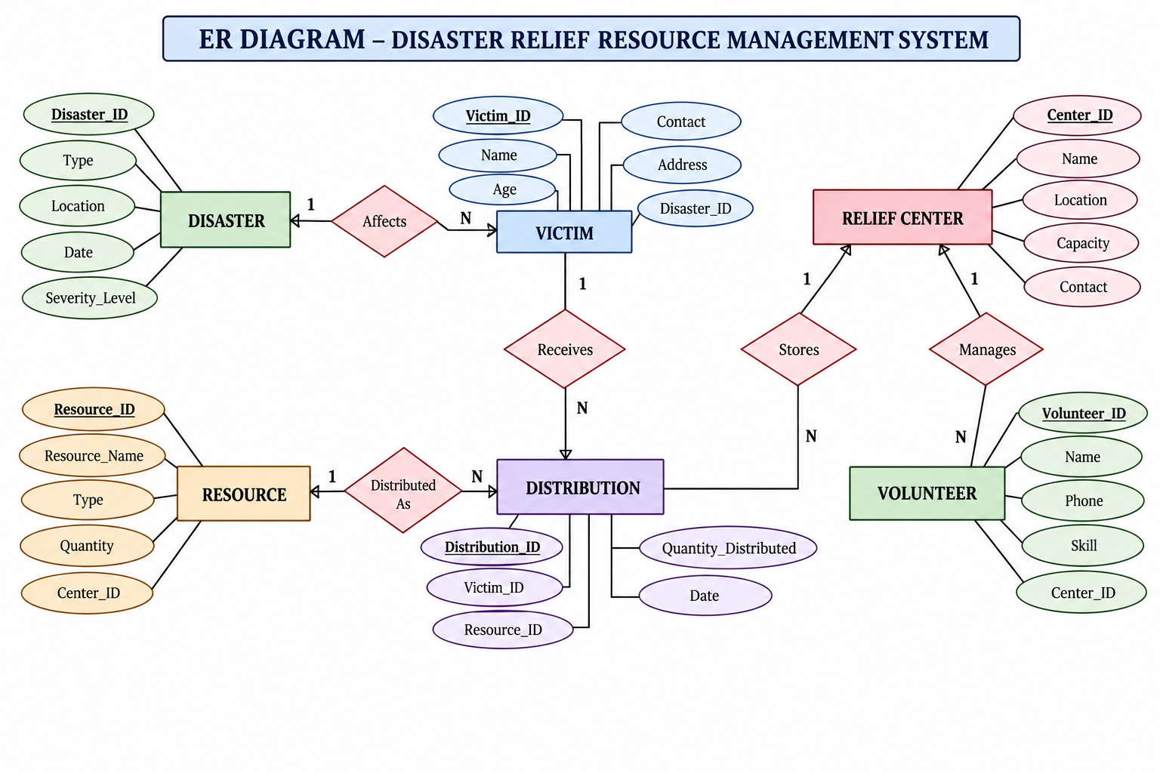
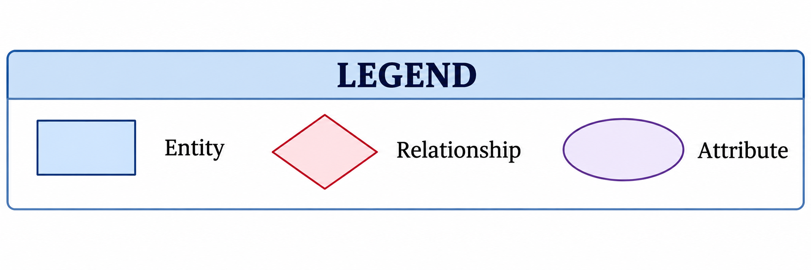
ENTITY-RELATIONSHIP DIAGRAM

Slide 22
Thank You

